Slide 1
Dylan’s Alternative Splice Site ExchangeR Supreme 3000 (DASSERS 3000)
Dylan (Xi Wang), Ph.D.
Harvard Medical School @ Boston Children’s Hospital
Dr. Sun Hur lab bioinformatics scientist
Ko-Wei’s Ph.D. classmate and buddy

Slide 2
Statement of the issue
Constructs need to be screened for alternative splice sites
The results are then screened manually (score > 8, confidence > 0.5)
These sites then need to be codon swapped one by one
The swapping is done with a “codon exchange sheet” that have scores for each codon (higher score -> higher protein expression)
Usually the swapping is done with codons with higher score
When all swapping is done, the new sequence is screened again for alternative splice sites
Some new sites may show up, and some old sites may need other codons. Basically, we repeat this process over and over again until no alternative splice sites show up.
Occasionally this cannot be solved after multiple rounds of swapping, this process is then stopped and the most favorable construct among existing options is picked (e.g. lowest counts of score >8)

Slide 3
Sequence sample and swapping, current method
The goal of this is to make sure I understand this process correctly before developing any strategies and writing codes

Slide 4
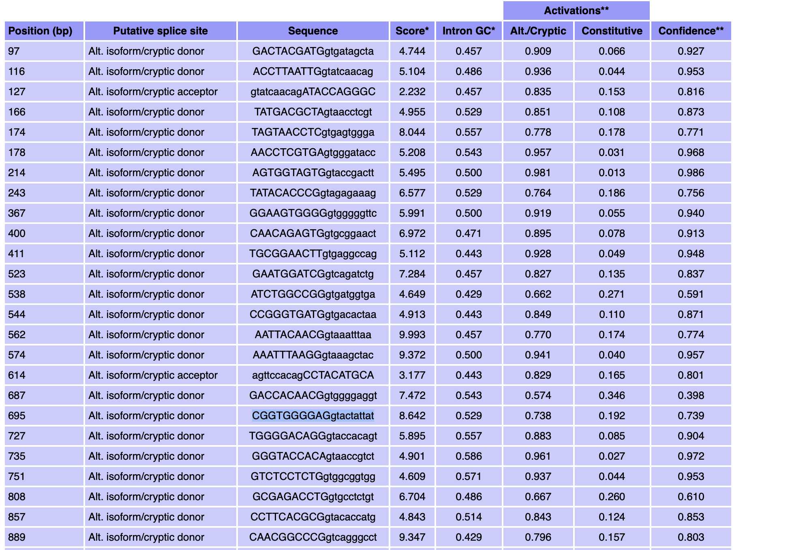
Get the sequence and replace nucleotide 695
CGGTGGGGAGgtactattat
Source: Ko-Wei

Slide 5
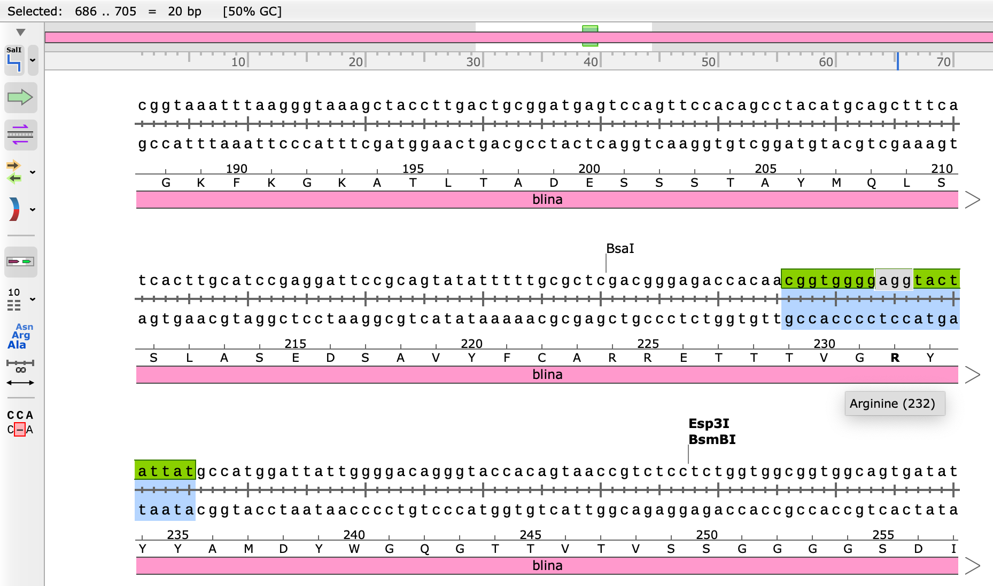
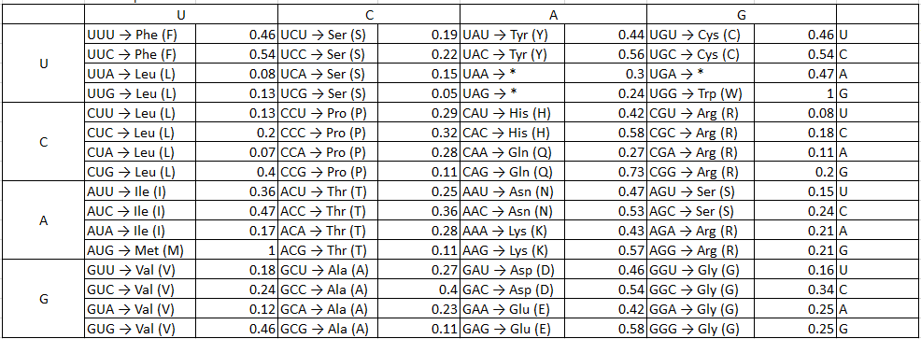
Nucleotide 695
The AGG (R) can be replace with AGA, CGG, CGC, CGA, CGU.
=> So it will be very helpful if we can quickly have the alternative codon table popped out when we click the “agg”
Source: Ko-Wei

Slide 6
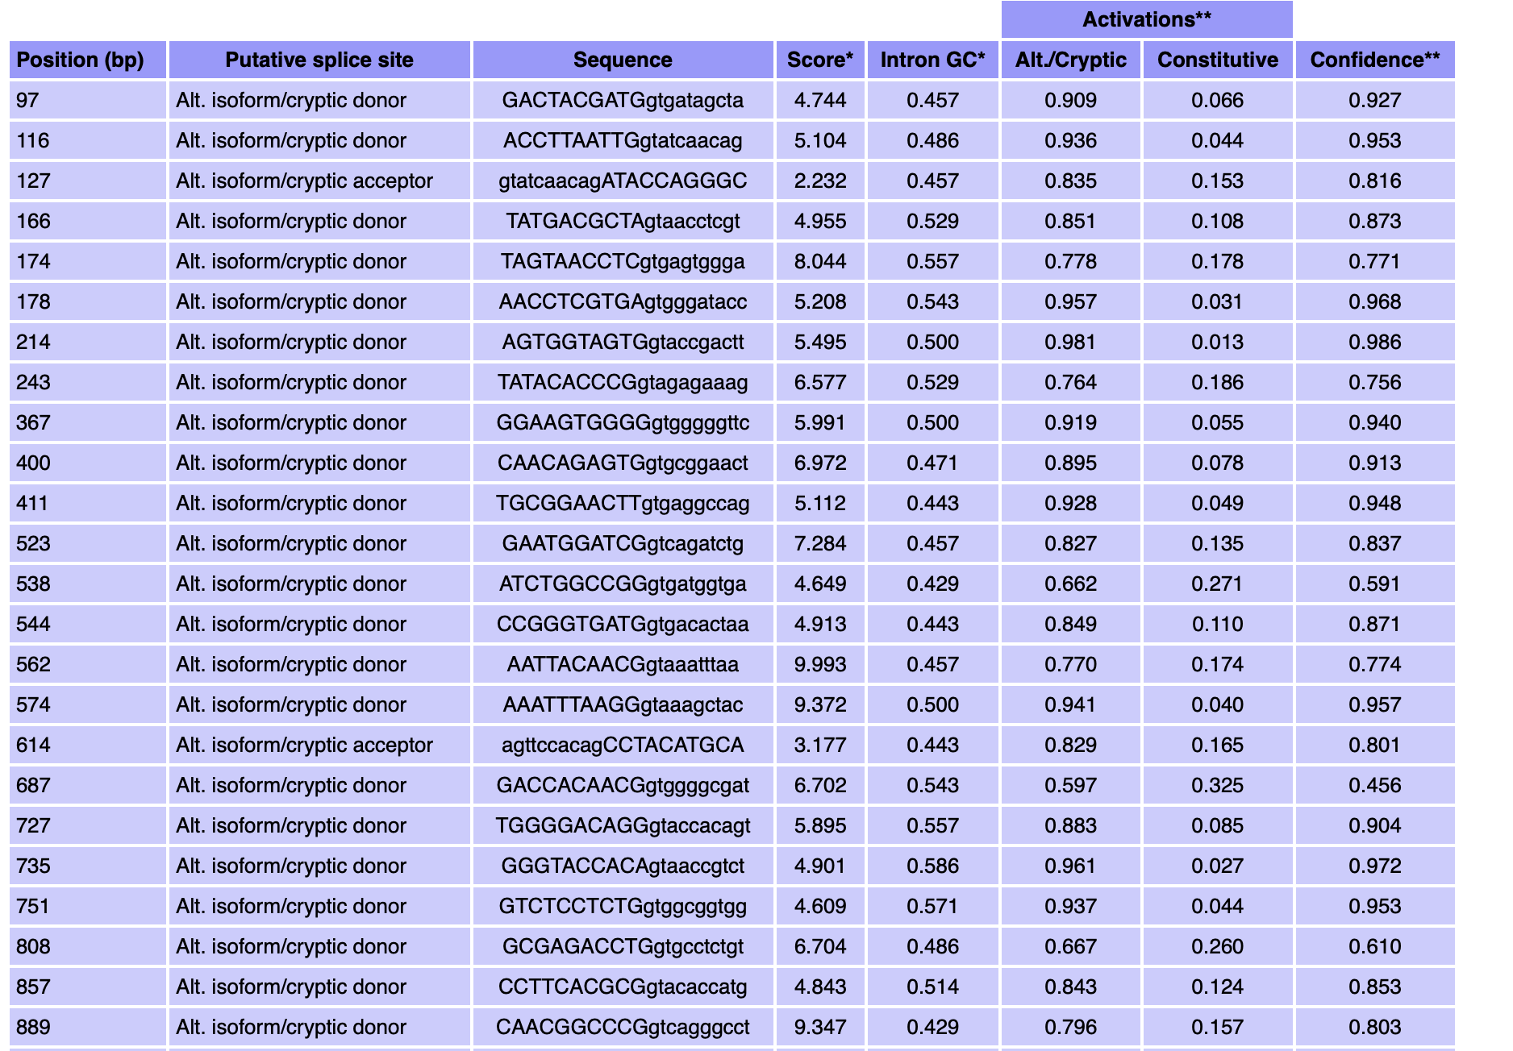
When we replace AGG (R) to CGA (R) and redo the alternative splicing analysis
And now we solved the alternative splicing site issue at nucleotide 695
Source: Ko-Wei

Slide 7
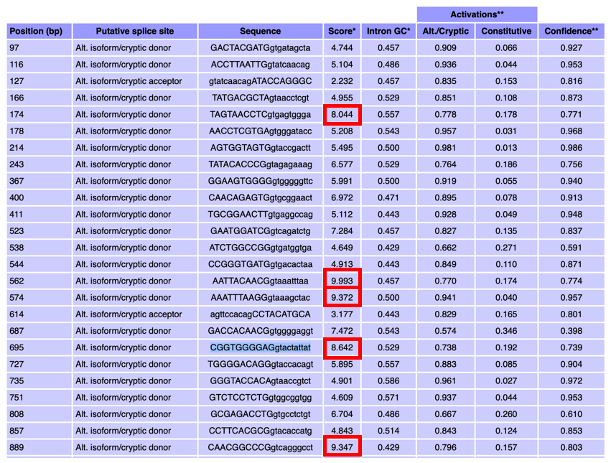
Total: 6 need to change
Source: Ko-Wei

Slide 8
Strategy development - background
My original design takes a “high throughput screening” process:
First we get the exact locations of codons to change
We then get AA based on codon sequence from exchange chart, and generate all possible combinations of all sequences in one Fasta file, and batch predict using the website’s MultiSeq function
For instance, in the sequence example Ko-Wei gave me, there are 6 sites to swap. Assuming each site has an average of 3 alternatives, we get 3^6=729 combinations
These 729 combinations are then used as input for website prediction, and the result is automatically analyzed. Sequences that pass will be ranked to get you the highest protein expression value

Slide 9
Strategy development - background
However, a critical flaw of this design is that some sequenceshave 20-30 swap sites. This gives us 3^20 to 3^30 combinations, which is an astronomical size of data to process (if it doesn’t crash the website, it will crash our analysis)
An alternative strategy is then developed:

Slide 10
Current strategy - threshold
For a swapping event to be attempted, the below conditions need to be met:
score > 8, confidence > 0.5
A separate warning message will occur if:
The codon to swap is tryptophan (e.g. no other alternative)
The codon to swap is constitutive donor/acceptor

Slide 11
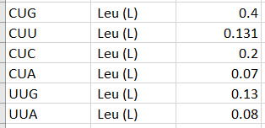
Current strategy
Here we assume a sequence with 10 swap sites
Each swap sites have multiple alternatives
We here present the swap sites as the “Nth” ranking in the codon swap sheet based on score
For instance, if the original codon that need to be swapped is “CUC”, then we represent it with number 3 because it’s the 3rd ranking on the codon exchange sheet

Slide 12
Swap example
With this method, a construct for codon swap can be represented in a series of numbers:
For instance, the construct with 10 swap sites is:
2, 3, 1, 4, 2, 1, 5, 3, 2, 2
The question then becomes, for each of the 10 swap sites, what is the correct number of ranking for each site
For instance, if the 2nd swap site is CUC, and the goal construct requires CUU to satisfy (score<8, confidence<0.5), then the correct number of this site is then 2
Let’s then assume the correct numbers are:
1, 2, 2, 1, 1, 3, 2, 4, 1, 3
With these swap sites, all will satisfy

Slide 13
Current strategy, continued
Here I propose a method called “swap to the Nth except this current one”
For instance,
If we “swap to 1st except current one”, then 2-6 will all be swapped to 1
But 1 will be swapped to 2
If we “swap to 3rd except current one”, then 1,2,4,5,6 will be swapped to 3
But 3 will be swapped to 4
We can then solve this problem with a couple rounds.
For short, let’s call this the “Nth swapper” function.

Slide 14
Current strategy, continued
Original construct
Goal construct (all score<8 and confidence<0.5)
2, 3, 1, 4, 2, 1, 5, 3, 2, 2
1, 2, 2, 1, 1, 3, 2, 4, 1, 3
1st swapper
No matter how many swap sites a construct has, the correct answer will be found in a couple rounds of Nth swappers (two 1st, then 2nd, 3rd, 4th, 5th)
1, 1, 2, 1, 1, 2, 1, 1, 1, 1
Predict again; if a site satisfy, it is no longer swapped
1, 1, 2, 1, 1, 2, 1, 1, 1, 1
1st swapper
1, 2, 2, 1, 1, 1, 2, 2, 1, 2
Predict again; if a site satisfy, it is no longer swapped
1, 2, 2, 1, 1, 1, 2, 2, 1, 2
2nd swapper
1, 2, 2, 1, 1, 3, 2, 3, 1, 3
Predict again; if a site satisfy, it is no longer swapped
1, 2, 2, 1, 1, 3, 2, 3, 1, 3
3rd swapper
Predict again; if a site satisfy, it is no longer swapped
1, 2, 2, 1, 1, 3, 2, 4, 1, 3
1, 2, 2, 1, 1, 3, 2, 4, 1, 3

Slide 15
Code pipeline in detail
Raw output is parsed with “|”
The nucleotide position, but not the exact codon to swap, is given:
For instance, we have position 695 to swap, but the codon is 694-696
We need the exact location of codon to get the sequence to query in exchange sheet
If we were given position 696, the codon is still 694-696
A conditional loop is used:
For any number N:
If the remainder of 3 is zero, the codon is N-2 to N (e.g. 696 gives us codon 694-696)
If the remainder of 3 is non-zero, the codon is:
M=N/3 and remove decimals;
Codon: 3M+1 to 3M+3;
This way, both 694, 695 and 696 give us codon 694-696

Slide 16
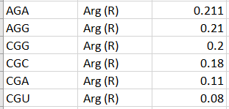
Code pipeline in detail, continued
Codon sequence 694-696 is acquired as AGG, which is Arg (R); based on the exchange sheet, the program will get:
The current AA of this location is Arg (R);
The current ranking value of this position is 2;
All possible codons and their ranking values are also stored for this location
The same thing will be done to all swap locations
After you choose “Nth swapper”, a new Fasta sequence as well as a datasheet, will be generated and saved to your current folder

Slide 17
Code pipeline in detail, continued
For instance, if we do the first “1st swapper” and save the new Fasta sequence as Testseq_1a, we get these two files:
The fasta file is the new input for the next round of prediction. The csv file is like this:
The columns contain the position to swap (e.g. 695), codon start and end (e.g. 694-696), AA (Arg), Score and Confidence, Original_Codon (AGG), Replaced_Codon (AGA), and some other columns from the website output.

Slide 18
Code pipeline in detail, full example
Take original sequence (Seq), predict by website, save result (Seq_result)
Run 1th swapper, save result (Seq1a_swap)
Take output fasta (Seq1a_swap.fasta) to predict by website, save result (Seq1a_result)
Run 1th swapper again, save result (Seq1b_swap)
Take output fasta (Seq1b_swap.fasta) to predict by website, save result (Seq1b_result)
Run 2th swapper, save result (Seq2_swap)…

Slide 19
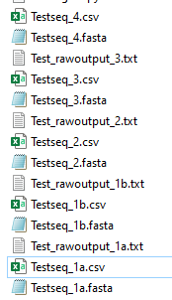
Code pipeline in detail, full example
Each round of “fasta -> website -> new fasta” takes about 10 seconds of clicking
The sample sequence took five rounds total (2-5 minutes total)
1st, 1st, 2nd, 3rd, 4th
Theoretically, all it takes are 6 rounds to swap everything
This method costs the same amount of time whether you have 3 swap sites or 3000 swap sites
If in case none satisfy after 5th round, start over from 1st round (this indicates you have recurring splice sites no matter how you swap it)

Slide 20
Updated feature as of Jan 2024
DASSER now swaps as many constructs as you want simultaneously
Simply concatenate your fasta files, feed to WangComputing multiseq and the rest is the same

